Slide 1


MAHENDRA COLLEGE OF ENGINEERING
CATCH ‘25 – Hackathon
Name of the College : Mahendra college of Engineering,Salem
Name of the Team : DKMN
Name of the Team Leader : Kavipriya S
Name of the Department : Biomedical engineering
Problem Statement : 3D-Printed Prosthetics: Design affordable and customizable prosthetic arm using 3D printing.
Date : 04/03/2025

Slide 2
CREW DETAILS
NAME OF THE STUDENT | YEAR | DEPARTMENT | DESIGNATION | E MAIL ID
KAVIPRIYA S | 3rd | Biomedical | Team Leader | kavipriya1914319@gmail.com
MADHUMITHA S | 3rd | Biomedical | Team Member | mathumithasingaravel@gmail.com
NIVETHA K | 3rd | Biomedical | Team Member | nivethakumaresan88@gmail.com
DEEPIKA D | 3rd | Biomedical | Team Member | keerthideepi464@gmail.com

Slide 3
MODULE LIST
ABSTRACT
IDEA/APPROACH DETAILS
FLOW CHART
TECH STACK AND DEPENDENCIES
METHODOLIGIES OR ALGORITHMS FOCUSED
ANALYSIS PART OF THEIR PROJECT
EXPECTED OUTCOME
SOCIAL RELEVANCE
CONCLUSION AND FUTURE WORK

Slide 4
ABSTRACT
Advancements in prosthetic technology have led to the development of 3D-printed prosthetic arms, offering affordable, customizable, and functional solutions for individuals with limb loss.
This study explores the design, fabrication, and functionality of a 3D-printed prosthetic arm, focusing on lightweight materials, modular components, and adaptive control systems.
Utilizing additive manufacturing, the prosthetic enhances accessibility while maintaining strength and durability.
The integration of myoelectric sensors and AI-driven grip patterns allows for improved dexterity and user experience.
This research highlights the potential of 3D printing to revolutionize prosthetics, making them more efficient, cost-effective, and widely available.

Slide 5
IDEA/APPROACH DETAILS
Affordable & Customizable: 3D printing makes prosthetics cheaper and easy to modify.
Lightweight & Strong: Uses durable materials like PLA, PETG, or carbon fiber reinforcements.
Smooth Movement: Uses tendon-driven or motorized mechanisms for finger and wrist motion.
Smart Control: Myoelectric sensors detect muscle signals for natural hand movements.
AI Assistance: Helps recognize different grip patterns for better usability.
Battery-Powered: Rechargeable battery with Bluetooth connectivity for adjustments.
Modular Design: Easy to repair, upgrade, or swap parts for personalization.
Hardware requirements: 3D printer, motors, Materials, sensors, control system.
Software requirements : Computer aided design software (CAD), 3D printing software, programming software.

Slide 6
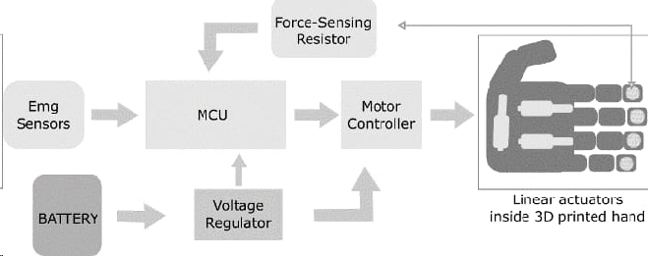
FLOW CHART

Slide 7

METHODOLIGIES OR ALGORITHMS FOCUSED
The methodology for a 3D-printed prosthetic arm begins with user assessment through 3D scanning to ensure a custom fit.
The prosthetic is then designed using CAD software, followed by simulation and validation to test movement and durability. 3D printing is performed using materials like PLA, PETG, or TPU, with post-processing steps such as sanding and coating for durability.
Electronics and actuation involve integrating myoelectric sensors, programming a microcontroller (Arduino/Raspberry Pi), and installing servo motors or actuators for movement.
The control algorithm processes muscle signals (EMG), enabling AI-powered grip recognition for adaptive hand gestures, making the prosthetic functional and user-friendly.
Flex sensors are commonly used in 3D printer prosthetic arms to detect finger or wrist movement, allowing for more precise control.

Slide 8
ANALYSIS OF THE PROJECT
STRENGTHS: 1.Customization 2.Cost-effective 3.Rapid prototyping 4.Improved fit and comfort
OPPORTUNITIES: 1.Increased accessibility 2.Personalization 3.Collaboration with medical professionals

Slide 9
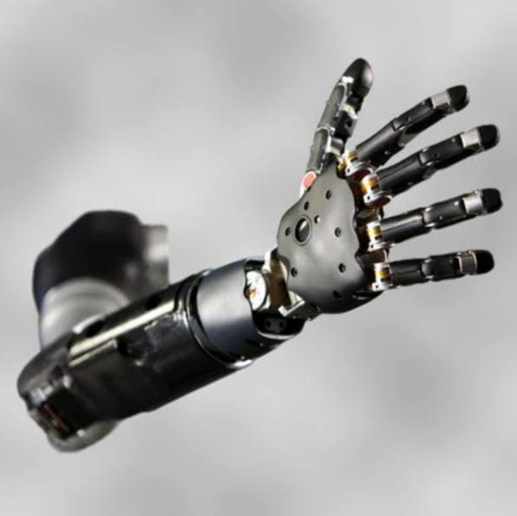
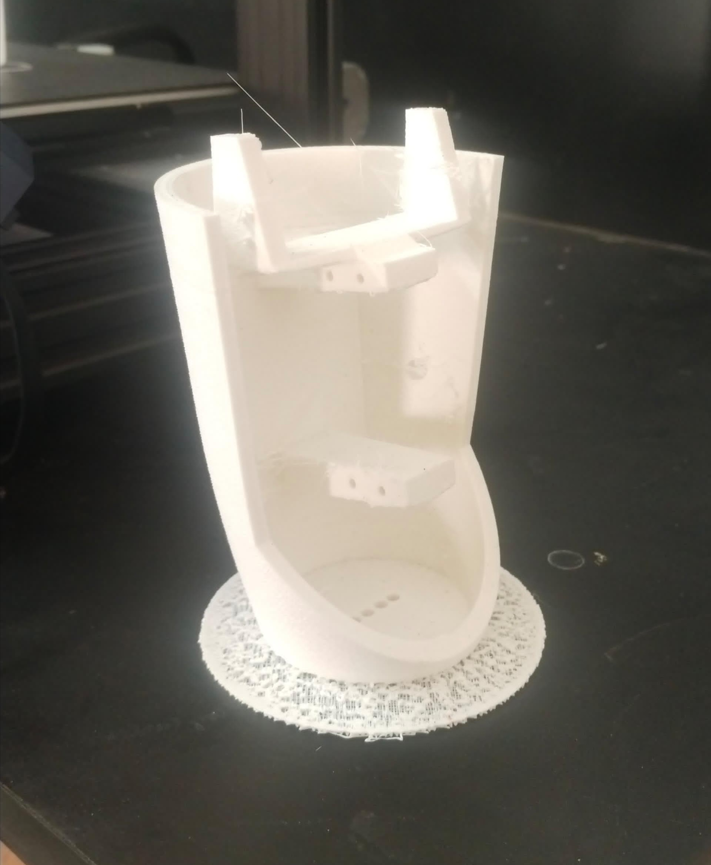
EXPECTED OUTCOME
A 3D-printed prosthetic arm offers affordability, customization, and accessibility. It improves basic functionality (gripping, holding), can include advanced features (finger movement, sensors), and is easier to repair. It boosts confidence, supports children's growth needs, and has potential for future tech integration like AI and bionics.

Slide 10
SOCIAL RELEVANCE
The social relevance of 3D-printed prosthetic arms lies in their affordability and accessibility, making prosthetics available to underserved communities. They also promote inclusivity and empowerment by offering personalized designs that boost confidence and reduce stigma.
Additionally, their sustainability helps reduce medical waste, while rapid production aids in disaster relief and war-torn areas. Ultimately, they go beyond replacing limbs—they restore dignity, foster inclusion, and reshape global healthcare.

Slide 11
CONCLUSION AND FUTURE WORK
Conclusion
3D-printed prosthetic arms have made prosthetics more affordable, accessible, and customizable, restoring independence and confidence. With ongoing innovations, they continue to improve in functionality, comfort, and inclusivity, shaping the future of assistive technology.
Future Work
Advancements will focus on AI, bionics, and haptic feedback for better movement, stronger and lighter materials for comfort, and smart connectivity for real-time adjustments. Efforts to reduce costs, enhance sustainability, and improve medical integration will make prosthetics more effective and widely available.

Slide 12
THANK YOU !

